Slide 1
Verification of ALU using UVM
By: Rowan Mohamed Naguib

Slide 2
AGENDA
ALU project flow
Verification Plan:
Design Requirements
Generation Requirements
Checking Requirements
Coverage Requirements
Architecture
Design flow chart
Results

Slide 3
ALU Project Workflow
PHASE1
PHASE2
PHASE3
PHASE4
PHASE5
Understanding the design specs
UVM environment architecting
Implementation of the UVM environment
Simulation Results
Making the verification plan

Slide 4
Verification Plan

Slide 5
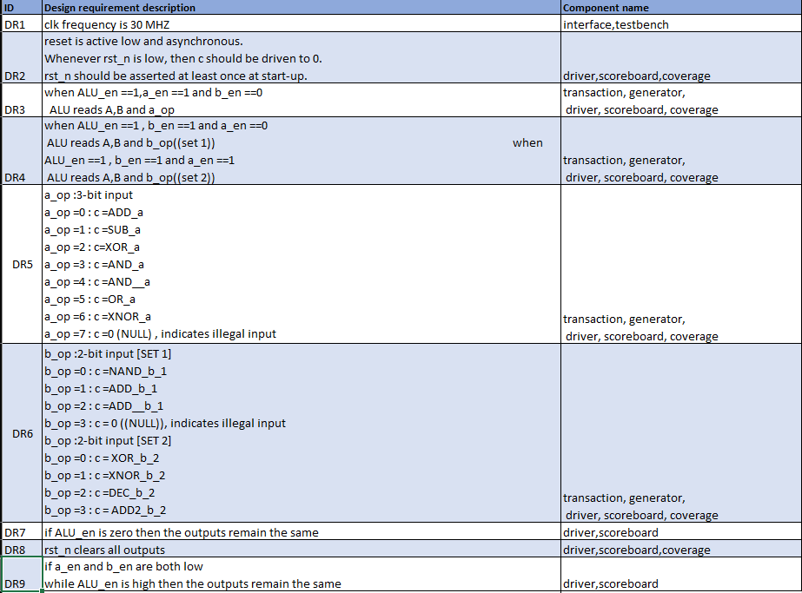

Slide 6
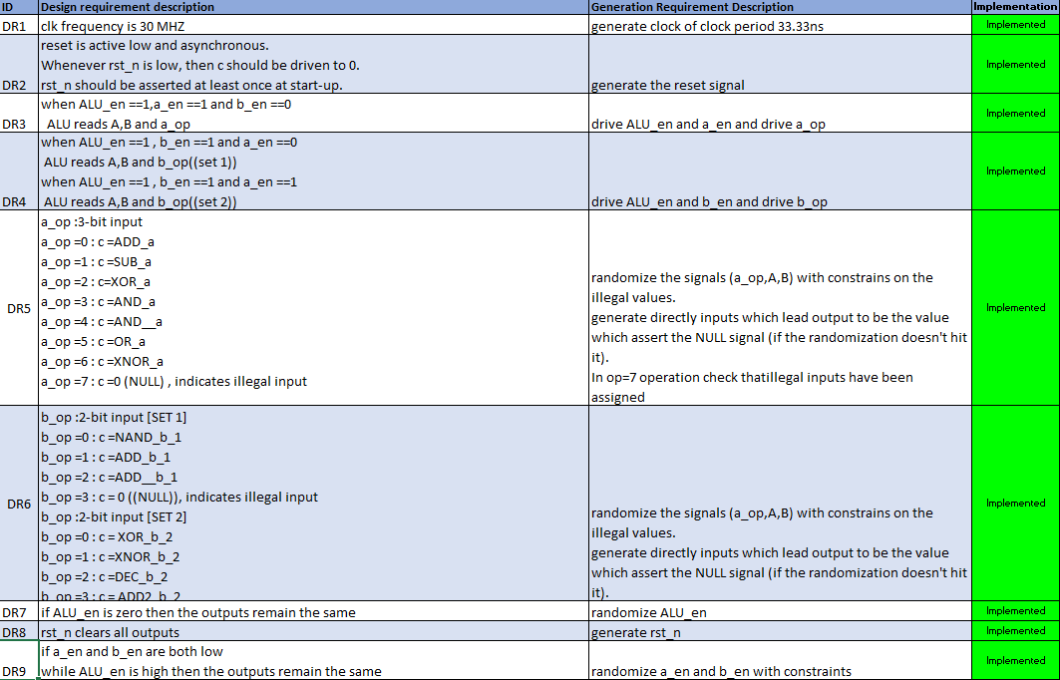

Slide 7
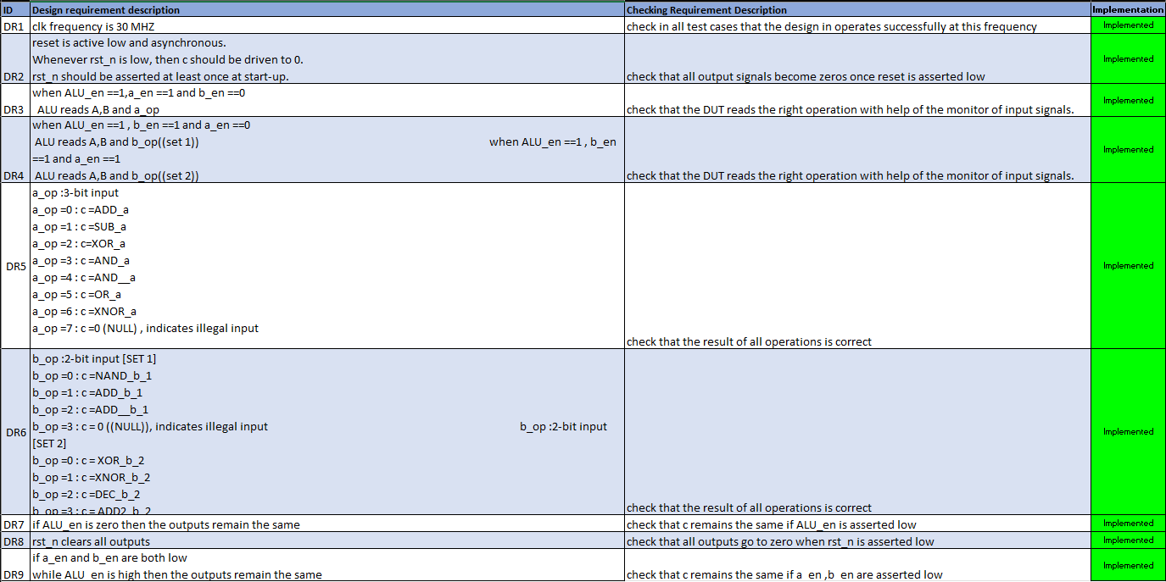

Slide 8
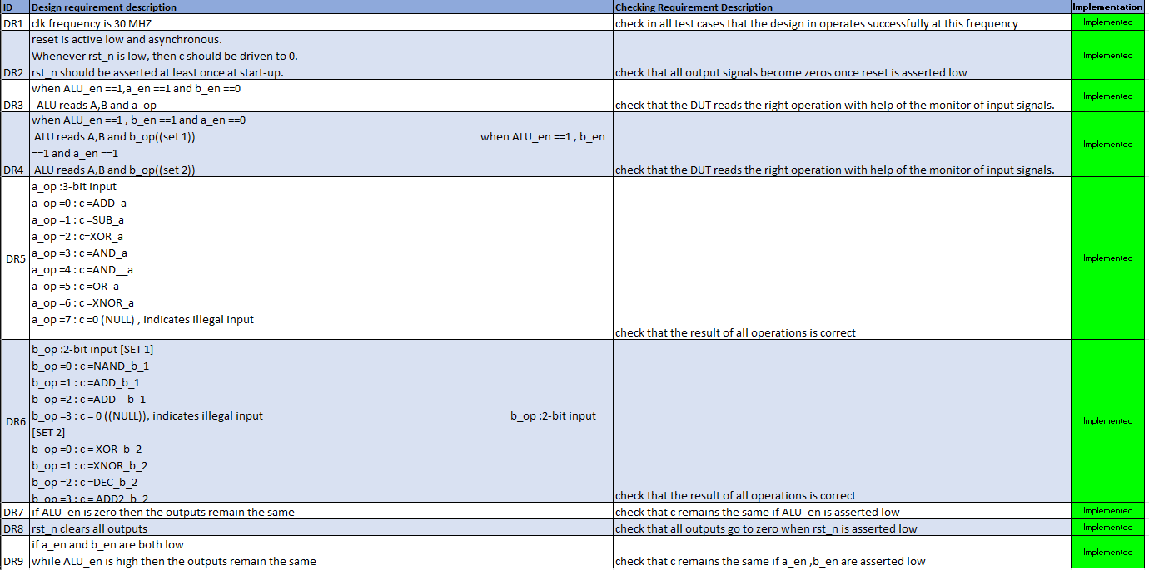

Slide 9
Architecture

Slide 10
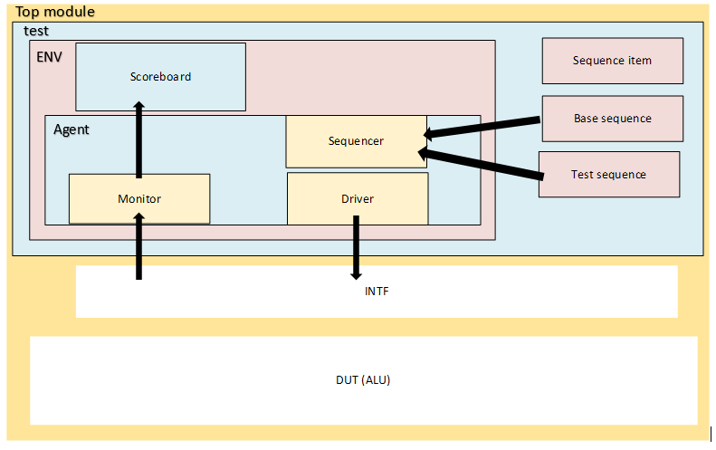

Slide 11
Design flowchart

Slide 12
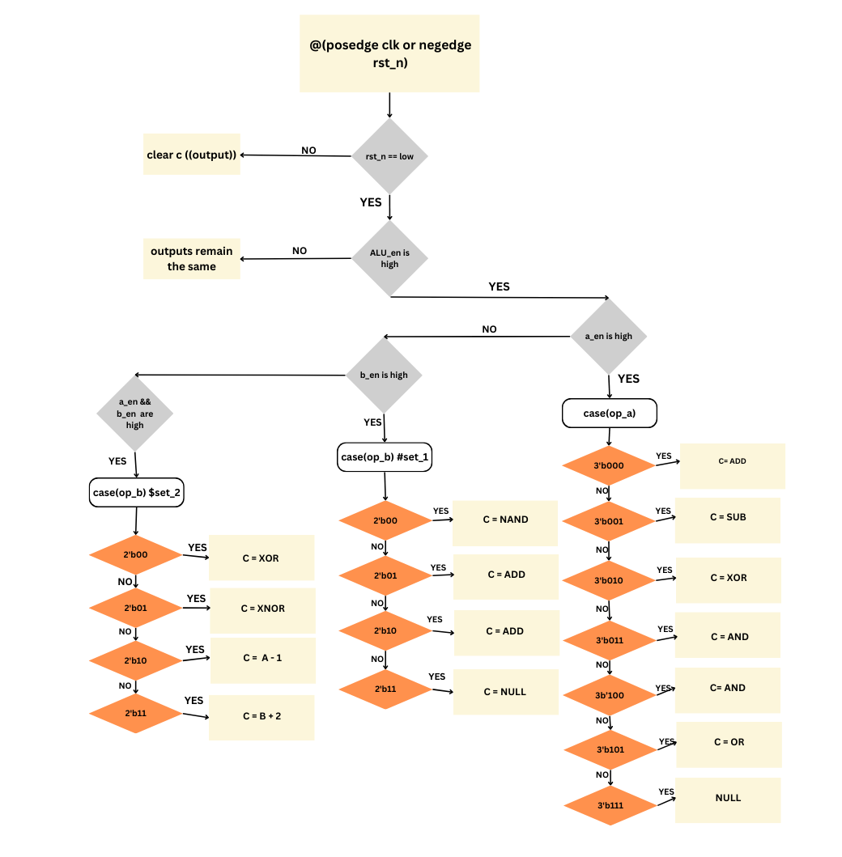

Slide 13
UVM Environment classes ->CHECK MY GITHUB LINK TO CHECK OUTPUT TRANSCIEPT, coverage closure & EDA LINK TO RUN THE CODE https://github.com/rowannaguib/UVM_ALU.git https://edaplayground.com/x/SFQD

Slide 14
THANK
YOU

